Slide 1
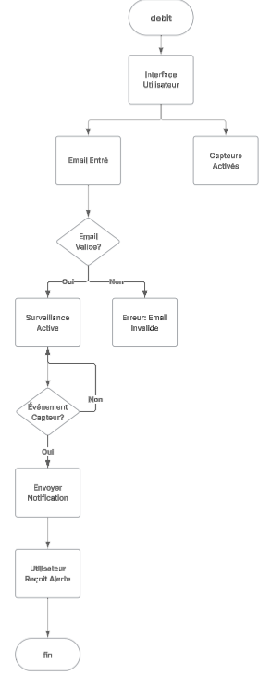
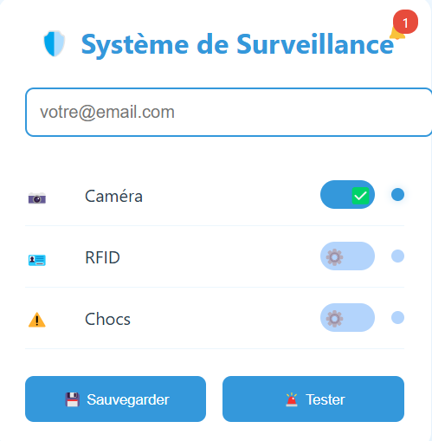
Système de Notification - Serviance
Configuration des Notifications - Serviance
Configuration des Notifications - Serviance

